Slide 1
Student Project:
Assistance Systems in Manufacturing 2
Real time human pose estimation for ergonomics awareness.
An open source approach!
Alexander Kinzer
Ing. Tudor Nichitov
Notes:
As students from TU Wien, we want to show one example of what is possible to achieve with modern technology concerning a well known problem.
make it look more modern than a university submission.
better quality graphics as support: boxes, arrows, highlights, charts..

Slide 2


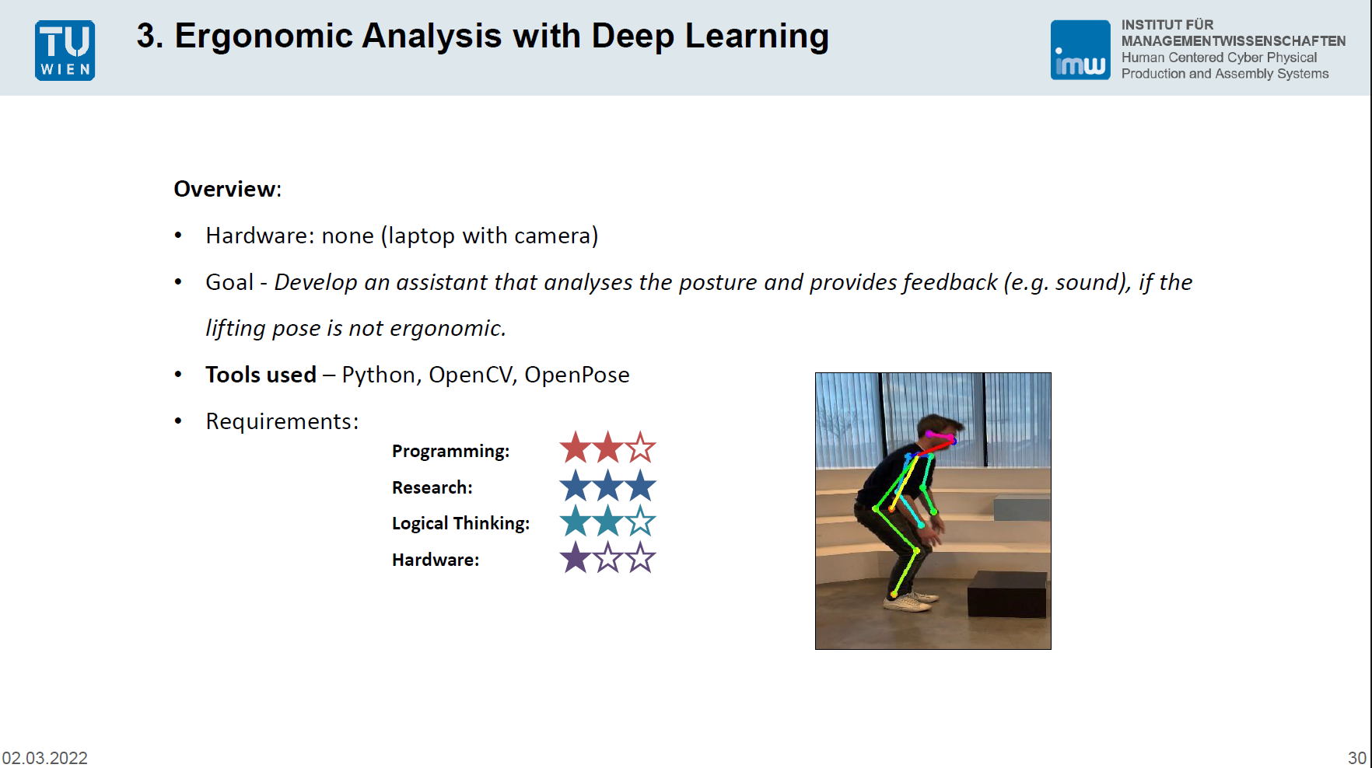
Introduction
ASSIGNMENT
Data Scientist & Mechanical Engineer + University Assignment with AI + 4-day-hackaton
Notes:
Present ourselves as students, different from managers. Show that we actually did the project ourselves: our background, our motivation, then into the topic.
Context in the introduction: lecture, what is the project, small part of the lecture. Refreshing presentation. We did that in 4 days... Comparing to papers: communicate that there is something AND try to figure out what advantages we have, what disadvantages exist.
Data Science and Mechanical Engineering student
interdisciplinary course
in a 4 day hackathon practical exercise
from defining the method how it should work, writing the software, and to testing it.
goal: accessible in real time ( put in 2 pictures from with sensors and with our solution)

Slide 3
Real World Application: Ergonomics Pose Awareness
„Worker’s movements can often be repetitive and strenuous.“
“Musculoskeletal disorder (MSD) cases represent about 60% of work-related disease cases registered in Europe.”
Among other measures, awareness of the worker about unhealthy postures can be improved.
Person-oriented ergonomics assessment procedures give us the right information.
The collection of information can be done by:
An expert monitoring work with a spreadsheet, followed by teaching the workers about their evaluation.
OR
using a web application on a laptop with the help of AI.
Notes:
show rise of AI applications over the last years, and how mature they are now.

Slide 4
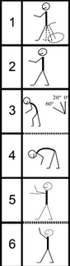
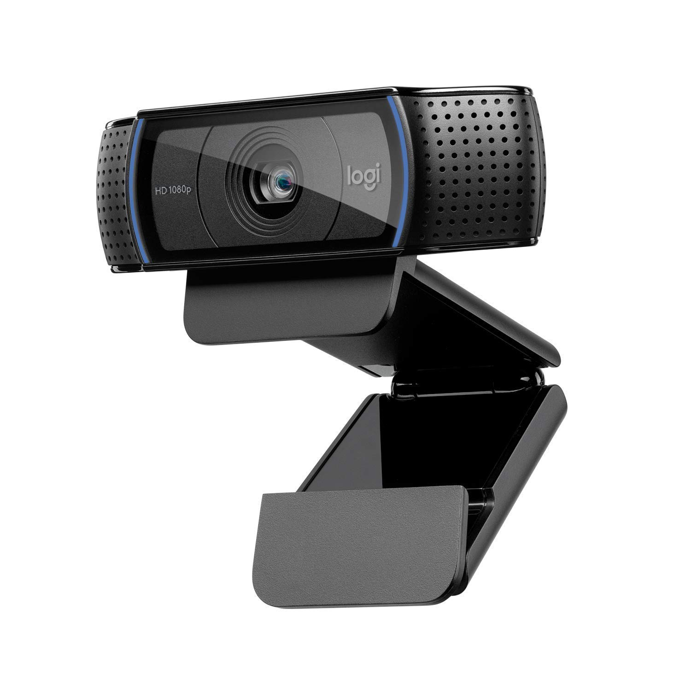



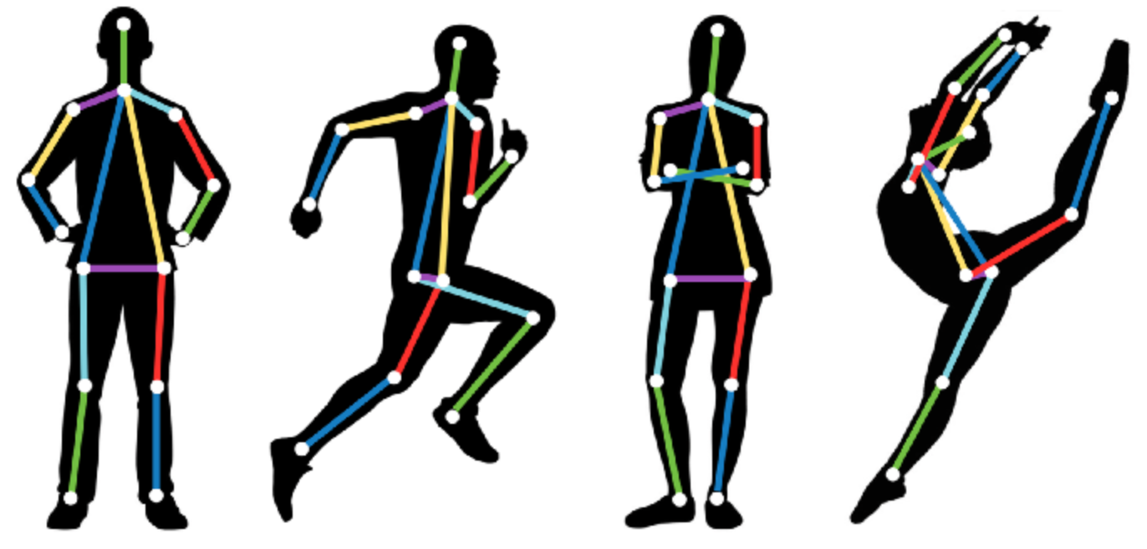
Assessment Method and Enabling Technologies
Applied Method:
Ergonomics Assessment Worksheet - EAWS
At industrial applications
looking for unhealthy postures
in frequent activities.
Information needed:
Upper body pose of torso and arms (> 4 seconds)
Used Technologies:
Laptop with webcam in 2D
available in companies and most homes
Google Colab
cloud service running python and using external GPU
Openpose
person keypoint detection
with machine learning algorithm
Conclusion: The technology is free of cost and available for everyone!
Notes:
Absolute values, not relative angles between limbs
as simple as possible, as complex as nescessary

Slide 5
Goal and Implementation
Goal:
Simple, free and accessible pose estimation.
Low deterrence:
App instead of hiring a professional
Raise awareness:
Sound feedback and saved information
Easy Implementation for people:
Free software
Usable anytime without additional hardware
Independent of used device

Slide 6
Slide for Video

Slide 7
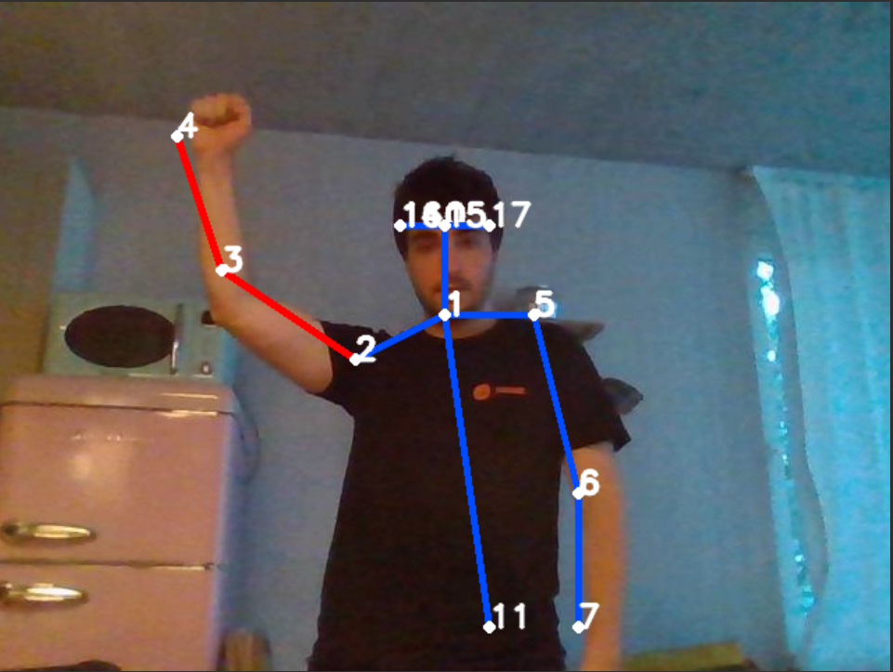
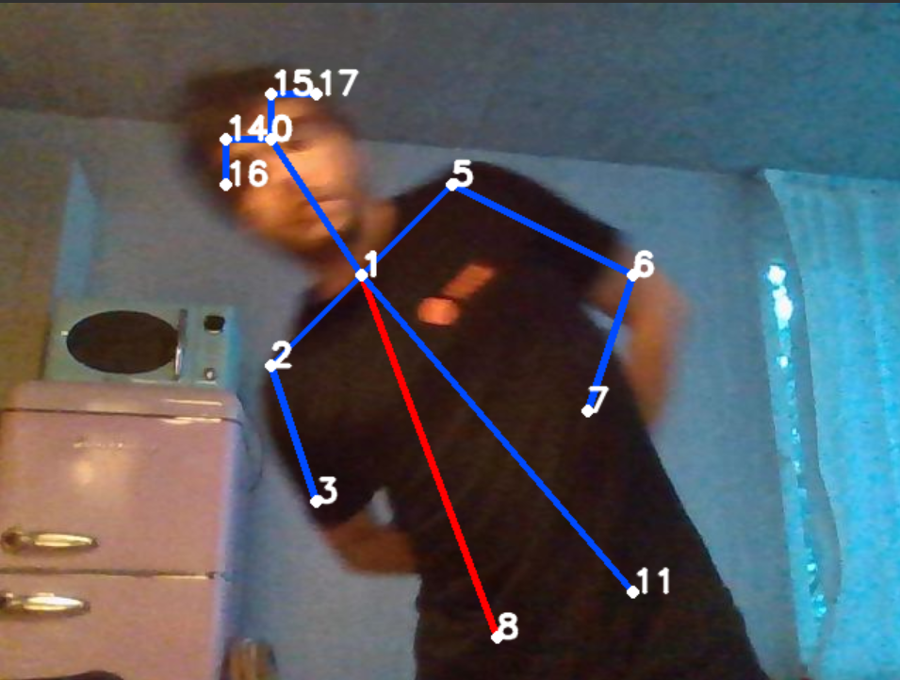
How it works - Frame evaluation
Every 2 seconds, a frame from the video is processed
The pose is detected
Criteria are applied:
Is the torso leaning >20° to the side or front?
Is the elbow above the shoulder?
Is the hand above the head?
For every detected criteria, a sound is played
Those criteria are marked in red in the frame
criteria examples

Slide 8
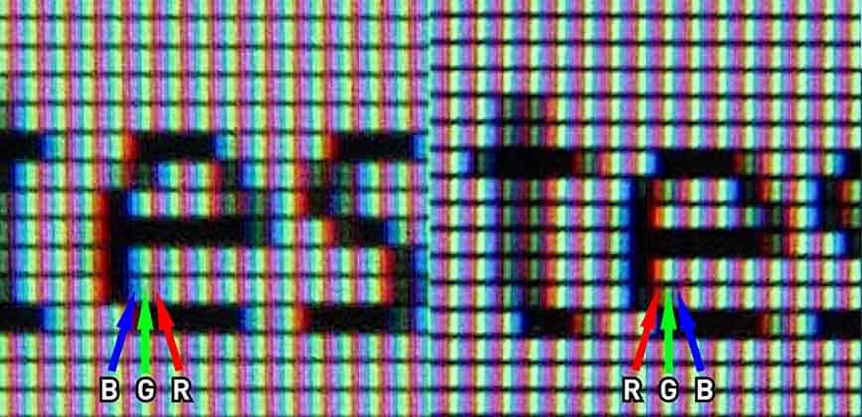
Technical Part - Helper Functions
Three simple functions used continuously throughout the application to capture
and process frames:
Live video stream using a Javascript API
Frame extraction from the video stream
Conversion of the JS frame into OpenCV image
BGR image vs RGB image

Slide 9
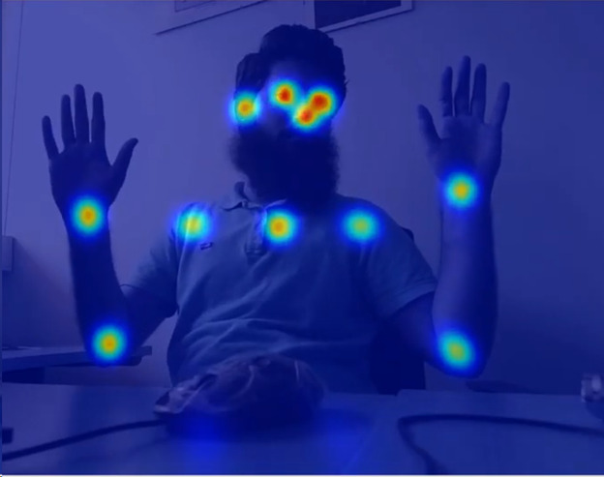
Technical Part - Model Initialization
This is a function called only once, at the start of the application, and is used to load the pre-trained model
Deep Learning model used to identify the body parts on an image
Input : OpenCV Image
Output: ‘Heatmap’ of body parts
Body Parts ‘Heatmap’

Slide 10
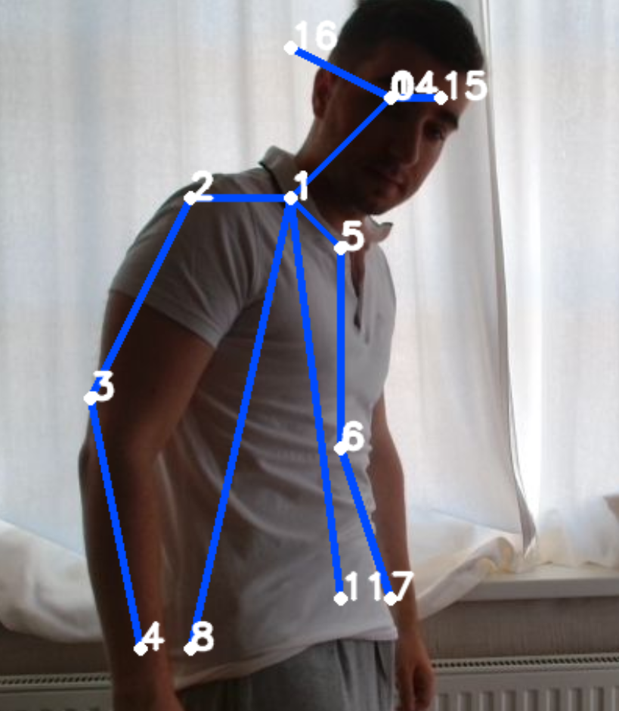
Technical Part - Model Initialization
Manual confidence threshold (accuracy vs quantity tradeoff)
Good performance with body part occlusion
Overall accuracy is good enough for pose evaluation
(Kim et al paper)
Realistic work conditions = non-ideal pictures! The software works.

Slide 11
Pose estimation and correction
The most important part of the project, used in a loop, while the camera is active
(each 2 seconds) and consists of three parts:
Producing the model output from the frame, which contains all correctly identified body parts and their coordinates
Interpreting the results to assess if the pose is ergonomic or not
elbow - shoulders and head - wrist: vertical coordinates are compared
back bending angle: computed using the neck and the hips
Displaying the identified body parts on the image and several audio and visual cues in case of an incorrect pose

Slide 12
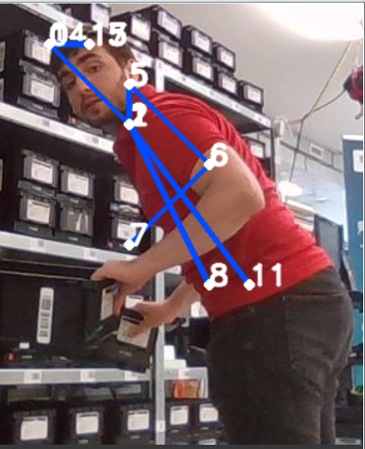
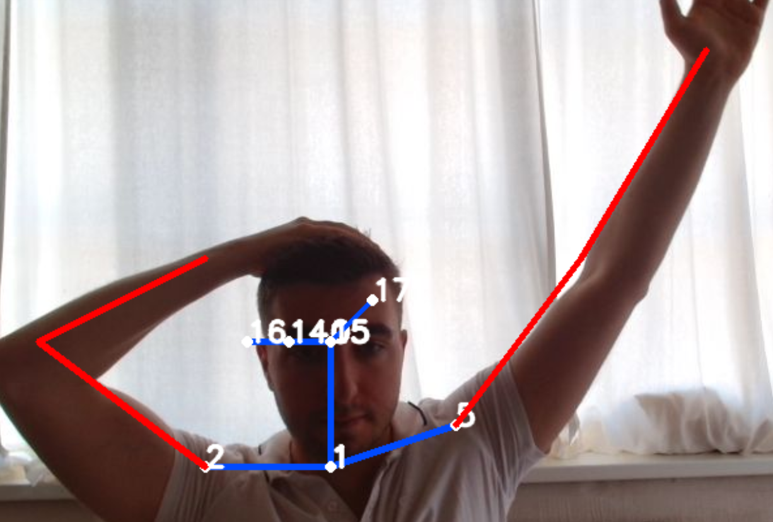
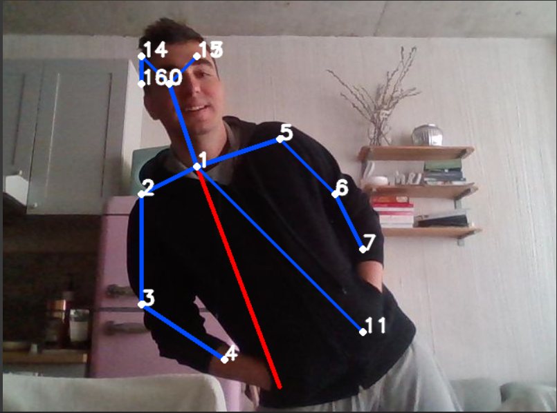
Pose estimation and correction - Criteria
Wrist + Head Back bent (frontal pose) Back bent (side pose)
Elbow vs Shoulders

Slide 13
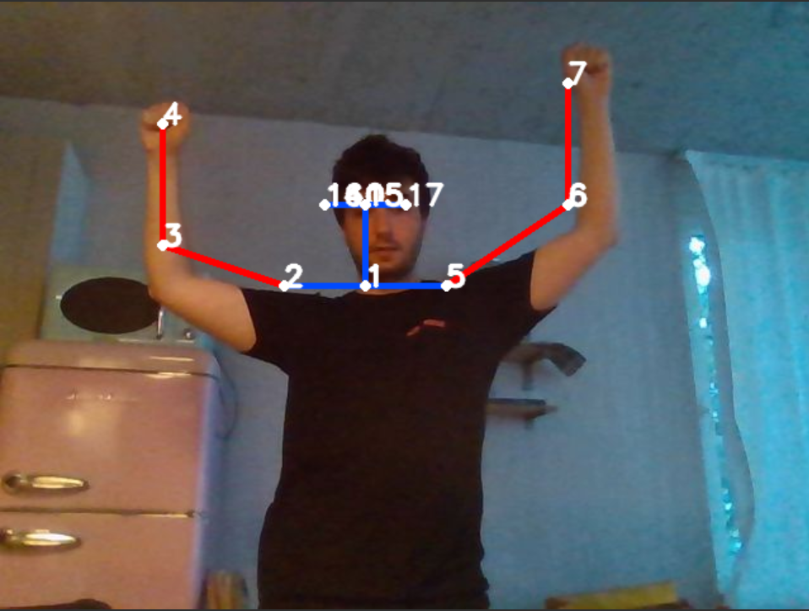
Conclusion
2D image from webcam is useable for ergonomics.
Novel machine learning algorithms and cloud computing open new possibilities for real time applications.
Students are able to develop such solutions in 4 days.
occasionally raising arms in cheering pose is not considered a health risk

Slide 14
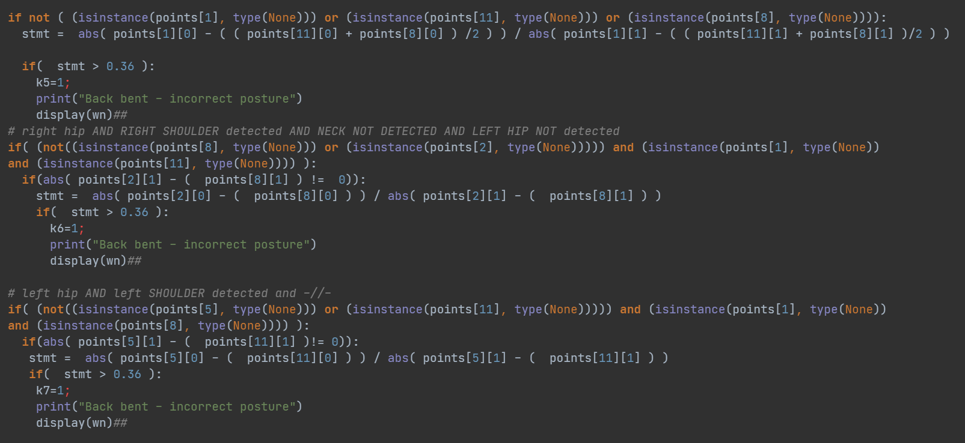
Further explaination of „Back Bent“ Criteria

Slide 15
DEMO - Video explanation
Simple process:
Position laptop
Enable camera and sound
Start web-app
Get feedback
Result:
Live video
Sound warning
Saved frames with information
(cut in screen capture)
Space for video

Slide 16
Backup: References
Digital Simulation of Ergonomics and Robotics (DSER) VU 330.291, S2021 – S.Schlund
https://link.springer.com/chapter/10.1007/978-981-15-4818-5_10
https://www.nature.com/articles/s41598-022-05812-9
https://colab.research.google.com/?utm_source=scs-index
https://viso.ai/deep-learning/openpose/
https://colab.research.google.com/github/tugstugi/dl-colab
notebooks/blob/master/notebooks/OpenPose.ipynb#scrollTo=xIt-eyIDO6XG
https://analyticsindiamag.com/guide-to-openpose-for-real-time-human-pose-estimation/
https://cmu-perceptual-computing-lab.github.io/openpose/web/html/doc/md_doc_02_output.html
https://cv-tricks.com/pose-estimation/using-deep-learning-in-opencv/
https://docs.opencv.org/4.x/d5/d1f/calib3d_solvePnP.html
https://learnopencv.com/image-alignment-feature-based-using-opencv-c-python/
https://pyimagesearch.com/2020/08/31/image-alignment-and-registration-with-opencv/
https://learnopencv.com/image-alignment-feature-based-using-opencv-c-python/
https://cmu-perceptual-computing-lab.github.io/openpose/web/html/doc/md_doc_02_output.html

Slide 17
Use Case - Limitations
The criteria for evaluation are based of the points in the frame of the image.
Evaluation quality relies on:
Setup:
camera parallel to the ground
full upper body in frame
Pose alorythm accuaracy
Chose frame during movement
2 second intervall
4 second criteria with EAWS
Space for video

